Slide 1
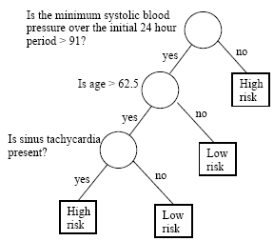
Classification using decision trees & rules Lantz Ch 5
A big advantage of classifiers is that the tree or rule structure is easily understandable and therefore a rational guide for humans.
Wk 3, Part 1
Notes:
Image from https://onlinecourses.science.psu.edu/stat557/node/83

Slide 2
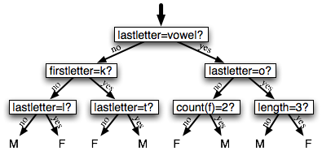
Decision trees
A lot like a diagnostic flow chart.
A series of logical decisions
Begin at root node
Nodes = decision points
Branches show the flow
Terminated by leaf nodes = final result
Can also be just descriptive (vs supervised learning)
Notes:
Example from http://www.nltk.org/book/ch06.html

Slide 3
A major branch of machine learning
The single most widely used method.
Can model almost any type of data.
Often provide accuracy and run fast.
Not so good if a large number of nominal features or a large number of numeric features.
Makes the “decision process” a big mess.

Slide 4
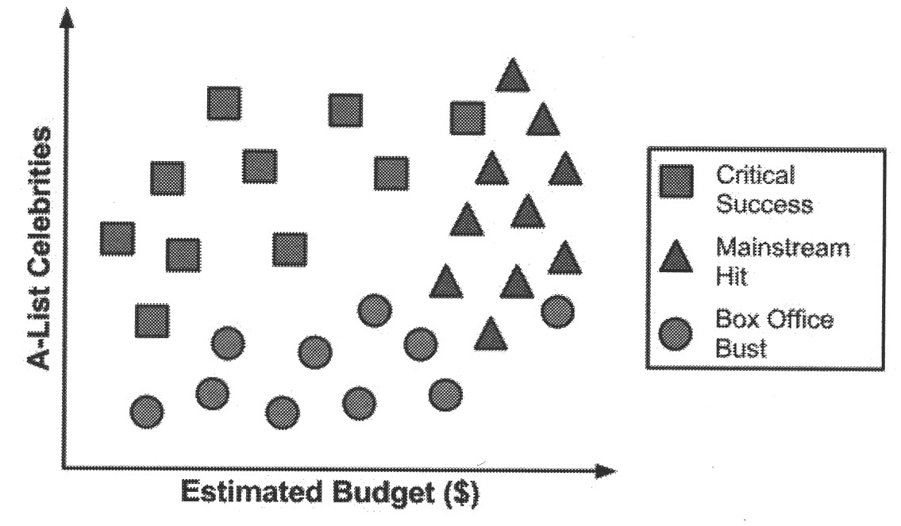
Recursive partitioning
Splits the data into smaller and smaller subsets
Starts by picking the first feature to use for splitting.
Stops at end of each branch when the class is determined, or we’re out of features.
Notes:
Lantz p 121

Slide 5
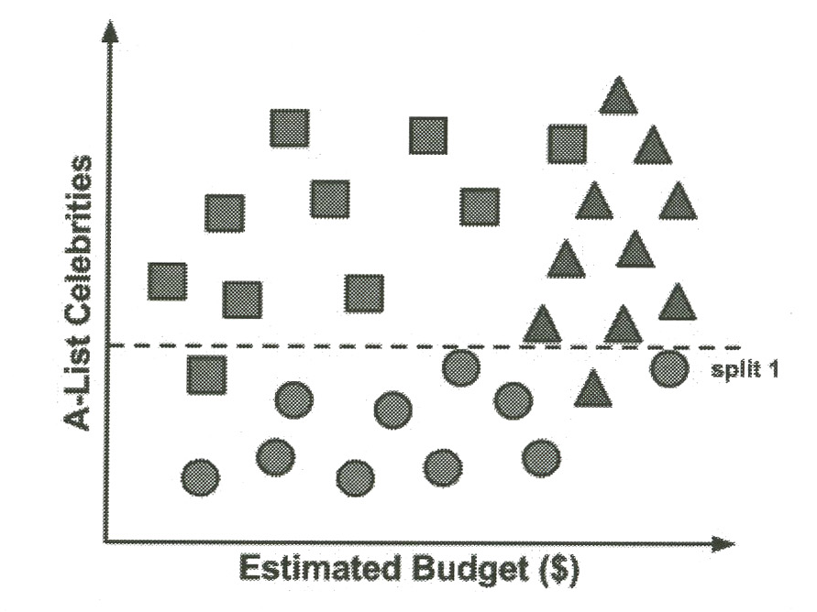
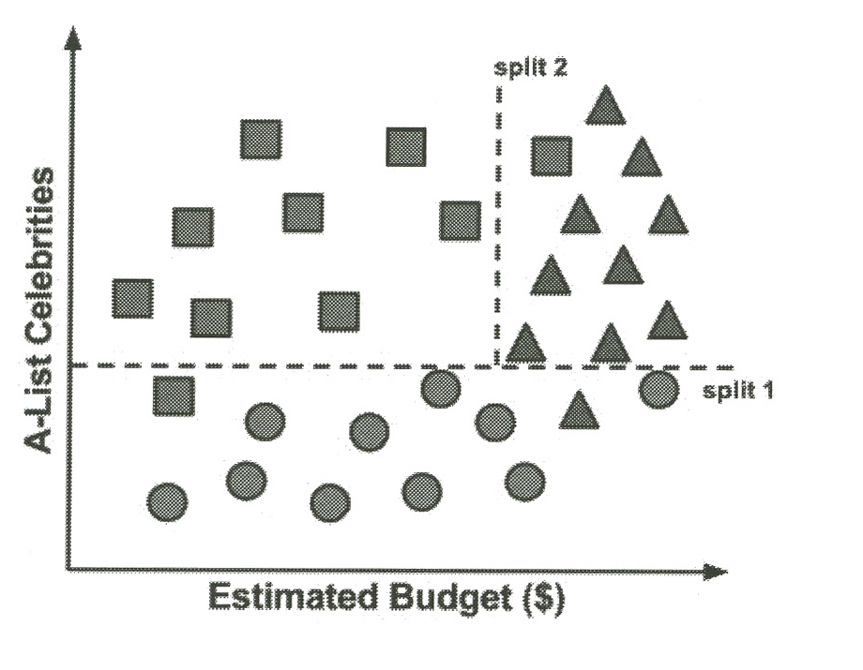
The splits!
Notes:
Lantz p 122

Slide 6
Axis-parallel splits
Decision trees split data based on one criterion at a time.
Maybe some combination would have worked better?
Trade-off of A-list celebrities vs budget?

Slide 7
Strengths | Weaknesses
An all-purpose classifier that does well on most problems. | Decision tree models are often biased toward splits on features having a large number of levels.
Highly-automatic learning process can handle numeric or nominal features, missing data. | It is easy to overfit or underfit the model.
Uses only the most important features. | Can have trouble modeling some relationships due to reliance on axis-parallel splits.
Can be used on data with relatively few training examples or a very large number. | Small changes in training data can result in large changes for decision logic.
Results in a model that can be interpreted without a mathematical background (for relatively small trees). | Large trees can be difficult to interpret and the decisions they make may seem counterintuitive.
More efficient than other complex models.
Notes:
Lantz p 125

Slide 8
Choosing the best split
Use “entropy” for measuring purity.
Indicate how mixed the class values are.
0 means completely homogenous.
1 means maximum disorder.
Sum over the class levels.
p_{i} is proportion of values falling into class level i.

Slide 9
Entropy example
A partition of data with two classes:
Red is 60%
White is 40%
Entropy is:
-0.60 * log2(0.60) -0.40 * log2(0.40)
= 0.97.
If this had been a 50/50 split, entropy would have been 1.

Slide 10
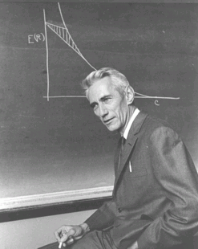
This comes out of Information Theory
Claude Shannon: “The goal of information is to reduce uncertainty.” He also contributed to the ideas behind decision trees:
The first notable use of decision trees was in EPAM, the "Elementary Perceiver And Memorizer” (Feigenbaum, 1961), which was a simulation of human concept learning_ IT)1 (Quinlan, 1979) added the crucial idea of choosing the attribute with maximum entropy; it is the basis for the [most common] decision tree algorithm. Information theory was developed by Claude Shannon to aid in the study of communication (Shannon and Weaver, 1949). (Shannon also contributed one of the earliest examples of machine learning, a mechanical mouse mimed Theseus that learned to navigate through a maze by trial and error.)
Notes:
Picture of Claude Shannon from http://chronicle.com/blognetwork/castingoutnines/2008/02/17/an-end-to-course-evaluations/.
Quote is from Stuart Russell and Peter Norvig, Artificial Intelligence, A Modern Approach, 3rd Ed, p. 778.

Slide 11
How it works
The ID3 algorithm builds the tree with the learning model like this:
Calculate the entropy of every attribute using the data set S
Split the set S into subsets using the attribute for which entropy is minimum (or, equivalently, information gain is maximum)
Make a decision tree node containing that attribute
Recurse on subsets using remaining attributes.
Notes:
From http://en.wikipedia.org/wiki/ID3_algorithm

Slide 12
In pseudocode
ID3 (Examples, Target_Attribute, Attributes)
Create a root node for the tree
If all examples are positive, Return the single-node tree Root, with label = +.
If all examples are negative, Return the single-node tree Root, with label = -.
If number of predicting attributes is empty, then Return the single node tree Root,
with label = most common value of the target attribute in the examples.
Otherwise Begin
A ← The Attribute that best classifies examples.
Decision Tree attribute for Root = A.
For each possible value, , of A,
Add a new tree branch below Root, corresponding to the test A = .
Let Examples() be the subset of examples that have the value for A
If Examples() is empty
Then below this new branch add a leaf node with label = most common target value in the examples
Else below this new branch add the subtree ID3 (Examples(), Target_Attribute, Attributes – {A})
End
Return Root
Notes:
From http://en.wikipedia.org/wiki/ID3_algorithm

Slide 13
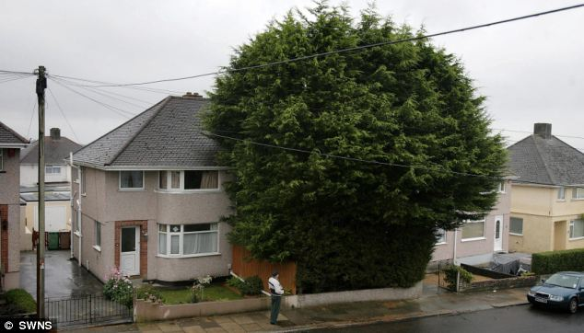
Pruning
How we keep a decision tree from becoming overly specific – and bushy.
Would be over-fitted to the training data.
Simplifies the tree structure.
Pre-pruning is a decision to stop even when the classes aren’t pure.
Post-pruning backs up to do the same thing.
Notes:
Tree from
http://www.dailymail.co.uk/news/article-1318627/Still-hacking-neighbours-Owner-35ft-leylandii-finally-gets-clippers---trim-BOTTOM.html

Slide 14
Major goals of decision trees
Come up with a parsimonious set of rules.
Occam’s razor and Minimum Description Length (MDL) are related:
The best hypothesis for a set of data is the one that leads to the best compression of the data.
Which neatly ties decision trees back to Information Theory.
A major goal of that was maximum compression.
Like, how to make the best use of telephone bandwidth.
Notes:
For more on MDL, see http://en.wikipedia.org/wiki/Minimum_description_length

Slide 15
Or,
Notes:
Cartoon from http://www.seanparnell.com/Hyperion%20Cantos/Web%20Pages/Occam's%20Razor.htm

Slide 16
Lantz’s example – risky bank loans
> str(credit)
'data.frame': 1000 obs. of 17 variables:
$ checking_balance : Factor w/ 4 levels "< 0 DM","> 200 DM",..: 1 3 4 1 1 4 4 3 4 3 ...
$ months_loan_duration: int 6 48 12 42 24 36 24 36 12 30 ...
$ credit_history : Factor w/ 5 levels "critical","good",..: 1 2 1 2 4 2 2 2 2 1 ...
$ purpose : Factor w/ 6 levels "business","car",..: 5 5 4 5 2 4 5 2 5 2 ...
$ amount : int 1169 5951 2096 7882 4870 9055 2835 6948 3059 5234 ...
$ savings_balance : Factor w/ 5 levels "< 100 DM","> 1000 DM",..: 5 1 1 1 1 5 4 1 2 1 ...
$ employment_duration : Factor w/ 5 levels "< 1 year","> 7 years",..: 2 3 4 4 3 3 2 3 4 5 ...
$ percent_of_income : int 4 2 2 2 3 2 3 2 2 4 ...
$ years_at_residence : int 4 2 3 4 4 4 4 2 4 2 ...
$ age : int 67 22 49 45 53 35 53 35 61 28 ...
$ other_credit : Factor w/ 3 levels "bank","none",..: 2 2 2 2 2 2 2 2 2 2 ...
$ housing : Factor w/ 3 levels "other","own",..: 2 2 2 1 1 1 2 3 2 2 ...
$ existing_loans_count: int 2 1 1 1 2 1 1 1 1 2 ...
$ job : Factor w/ 4 levels "management","skilled",..: 2 2 4 2 2 4 2 1 4 1 ...
$ dependents : int 1 1 2 2 2 2 1 1 1 1 ...
$ phone : Factor w/ 2 levels "no","yes": 2 1 1 1 1 2 1 2 1 1 ...
$ default : Factor w/ 2 levels "no","yes": 1 2 1 1 2 1 1 1 1 2 …

Slide 17
2 - Investigate the data
> table(credit$checking_balance)
< 0 DM > 200 DM 1 - 200 DM unknown
274 63 269 394
> table(credit$savings_balance)
< 100 DM > 1000 DM 100 - 500 DM 500 - 1000 DM unknown
603 48 103 63 183
> summary(credit$months_loan_duration)
Min. 1st Qu. Median Mean 3rd Qu. Max.
4.0 12.0 18.0 20.9 24.0 72.0
> summary(credit$amount)
Min. 1st Qu. Median Mean 3rd Qu. Max.
250 1366 2320 3271 3972 18420

Slide 18
Randomize the data examples!
> set.seed(12345)
>credit_rand <- credit[order(runif(1000), ]
Somehow, this “uniform” distribution doesn’t repeat or miss any rows. E.g.,
> order(runif(10))
[1] 4 2 1 3 10 6 5 7 9 8
Obviously important to make a new matrix!

Slide 19
Split into training and testing sets
And compare to be sure they are “comparable”:
> prop.table(table(credit_train$default))
no yes
0.7022222 0.2977778
> prop.table(table(credit_test$default))
no yes
0.68 0.32

Slide 20
3 – Train a model on the data
> credit_model
Call:
C5.0.default(x = credit_train[-17], y = credit_train$default)
Classification Tree
Number of samples: 900
Number of predictors: 16
Tree size: 67
Non-standard options: attempt to group attributes
>
Two ways of naming the dependent variable here!
Lantz doesn’t explain this message, but it appears in other examples on the web.

Slide 21
Training results
> summary(credit_model)
Call:
C5.0.default(x = credit_train[-17], y = credit_train$default)
C5.0 [Release 2.07 GPL Edition] Fri Dec 12 07:07:27 2014
-------------------------------
Class specified by attribute `outcome'
Read 900 cases (17 attributes) from undefined.data
Decision tree:
checking_balance = unknown: no (358/44)
checking_balance in {< 0 DM,> 200 DM,1 - 200 DM}:
:...credit_history in {perfect,very good}:
:...dependents > 1: yes (10/1)
: dependents <= 1:
: :...savings_balance = < 100 DM: yes (39/11)
: savings_balance in {> 1000 DM,500 - 1000 DM,unknown}: no (8/1)
: savings_balance = 100 - 500 DM:
: :...checking_balance = < 0 DM: no (1)
: checking_balance in {> 200 DM,1 - 200 DM}: yes (5/1)
credit_history in {critical,good,poor}:
:...months_loan_duration <= 11: no (87/14)
months_loan_duration > 11:
:...savings_balance = > 1000 DM: no (13)
savings_balance in {< 100 DM,100 - 500 DM,500 - 1000 DM,unknown}:
:...checking_balance = > 200 DM:
:...dependents > 1: yes (3)
: dependents <= 1:
: :...credit_history in {good,poor}: no (23/3)
: credit_history = critical:
: :...amount <= 2337: yes (3)
: amount > 2337: no (6)
checking_balance = 1 - 200 DM:
:...savings_balance = unknown: no (34/6)
: savings_balance in {< 100 DM,100 - 500 DM,500 - 1000 DM}:
If checking account balance is unknown, then classify as not likely to default!
(But this was wrong in 44 of 358 cases.)

Slide 22
Relook at the data!
Why were there only 44 defaults out of 358 examples where the checking balance was unknown?
Why did 9 out of 10 default when their credit history was very good or perfect, if they had more than one dependent?
Why did only 6 of 26 default, whose checking balance was less than zero, if their job was “management”?

Slide 23
More training results
Evaluation on training data (900 cases):
Decision Tree
----------------
Size Errors
66 125(13.9%) <<
(a) (b) <-classified as
---- ----
609 23 (a): class no
102 166 (b): class yes
E.g., 23 who did not default were classified with the defaults by the decision tree.

Slide 24
4 – Evaluate model performance
Results using the test data:
> CrossTable(credit_test$default, credit_pred, prop.chisq = FALSE, prop.c = FALSE, prop.r = FALSE, dnn = c('actual default', 'predicted default'))
Total Observations in Table: 100
| predicted default
actual default | no | yes | Row Total |
---------------|-----------|-----------|-----------|
no | 57 | 11 | 68 |
| 0.570 | 0.110 | |
---------------|-----------|-----------|-----------|
yes | 16 | 16 | 32 |
| 0.160 | 0.160 | |
---------------|-----------|-----------|-----------|
Column Total | 73 | 27 | 100 |
---------------|-----------|-----------|-----------|
Only 27 (out of 100) errors overall
But 50% of defaults are predicted to be non-defaults. Could be costly!

Slide 25
5 – Improving model performance
Build separate decision trees, then compare and pick.
How about doing this 10x?
> credit_boost10
Call:
C5.0.default(x = credit_train[-17], y = credit_train$default, trials = 10)
Classification Tree
Number of samples: 900
Number of predictors: 16
Number of boosting iterations: 10
Average tree size: 56
Non-standard options: attempt to group attributes

Slide 26
Gives some improvement
> CrossTable(credit_test$default, credit_boost_pred, prop.chisq = FALSE, prop.c = FALSE, prop.r = FALSE, dnn = c('actual default', 'predicted default'))
Total Observations in Table: 100
| predicted default
actual default | no | yes | Row Total |
---------------|-----------|-----------|-----------|
no | 60 | 8 | 68 |
| 0.600 | 0.080 | |
---------------|-----------|-----------|-----------|
yes | 15 | 17 | 32 |
| 0.150 | 0.170 | |
---------------|-----------|-----------|-----------|
Column Total | 75 | 25 | 100 |
---------------|-----------|-----------|-----------|
Now only 23 (out of 100) errors overall, instead of 27.
But we’re still wrong 47% of the time on defaults.

Slide 27
A theoretical note…
We tried 10 variations on designing the tree, here, with the 10 trials.
There were 16 predictors in play.
To do an exhaustive job finding the MDL (Ref slide 12), we might need to try 2¹⁶ designs!
Exponential complexity, that has.
And mostly, refining noise, we’d be.
Notes:
Yoda image from http://www.comicvine.com/yoda/4005-5396/.

Slide 28
New angle – Make some errors more costly!
> error_cost
[,1] [,2]
[1,] 0 4
[2,] 1 0
> credit_cost <- C5.0(credit_train[-17], credit_train$default, costs = error_cost)
Since a loan default costs 4x as much as a missed opportunity.

Slide 29
How does this one work out?
> credit_cost_pred <- predict(credit_cost, credit_test)
> CrossTable(credit_test$default, credit_cost_pred, prop.chisq = FALSE, prop.c = FALSE, prop.r = FALSE, dnn = c('actual default', 'predicted default'))

Slide 30
It yields “confusion matrix” of…
Cell Contents
|-------------------------|
| N |
| N / Table Total |
|-------------------------|
Total Observations in Table: 100
| predicted default
actual default | no | yes | Row Total |
---------------|-----------|-----------|-----------|
no | 42 | 26 | 68 |
| 0.420 | 0.260 | |
---------------|-----------|-----------|-----------|
yes | 6 | 26 | 32 |
| 0.060 | 0.260 | |
---------------|-----------|-----------|-----------|
Column Total | 48 | 52 | 100 |
---------------|-----------|-----------|-----------|
More errors (32 vs 23) overall
But only 25% of defaults are predicted to be non-defaults.

Slide 31
New topic – Classification Rules
Vs trees
Separate and conquer is the strategy.
Identify a rule that covers a subset, then pull those out and look at the rest.
Keep adding rules till the whole dataset has been covered.
Emphasis is on finding rules to identify every example which passes some test.

Slide 32
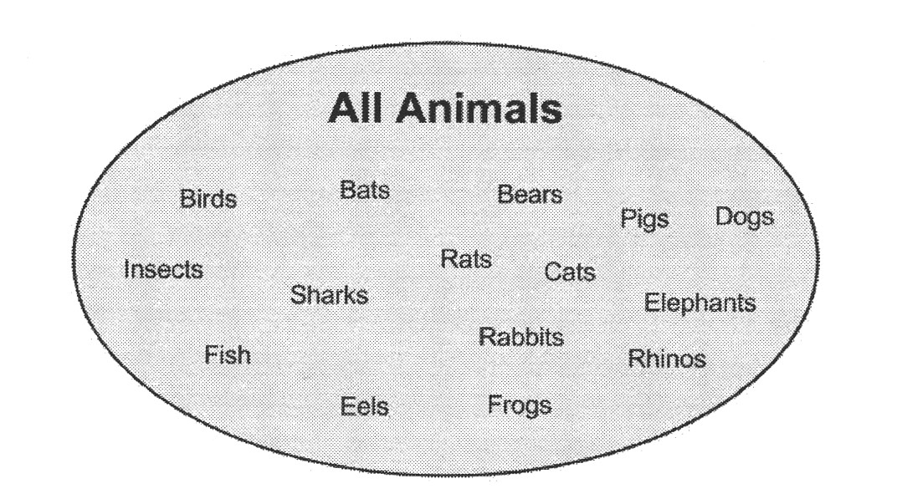
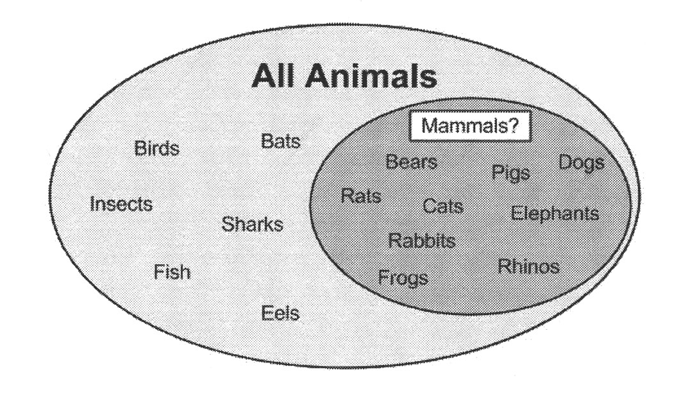
Carving up the animal kingdom
Starting with the most definitive slice
Notes:
Lantz p 143

Slide 33
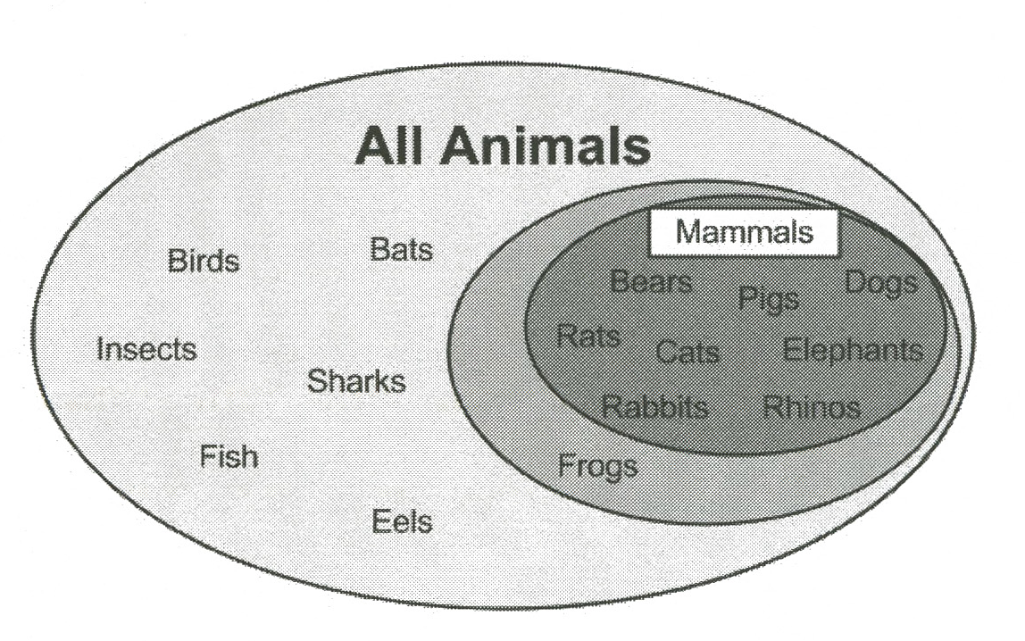
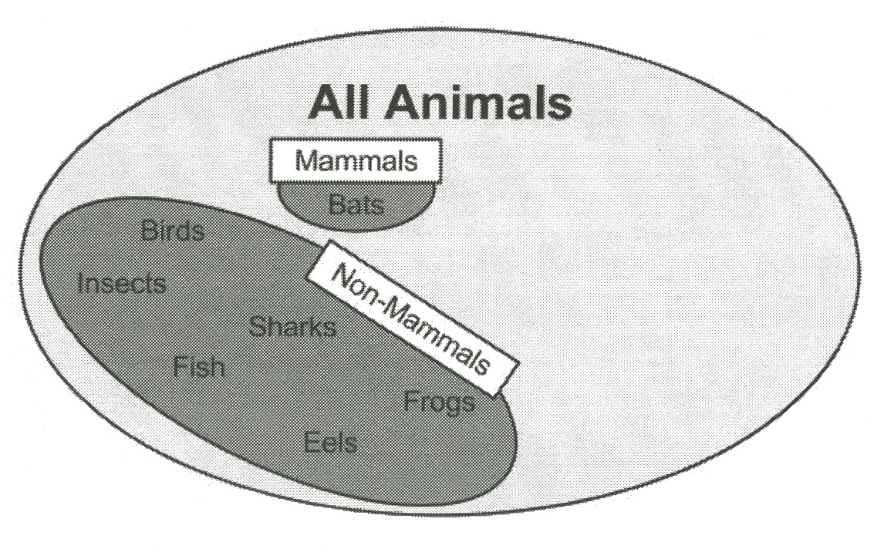
Keep perfecting it what’s left…
Notes:
Lantz pp 144

Slide 34
The RIPPER algorithm
Strengths | Weaknesses
Generates easy-to-understand, human-readable rules. | May result in rules that seem to defy common sense or expert knowledge.
Efficient on large and noisy datasets. | Not ideal for working with numeric data.
Generally produces a simpler model than a comparable decision tree. | Might not perform as well as more complex models.
How it works:
Grow
Prune
Optimize
Separate and conquer
Greedily adds conditions to a rule

Slide 35
Example – Identifying mushrooms
> str(mushrooms)
'data.frame': 8124 obs. of 23 variables:
$ type : Factor w/ 2 levels "edible","poisonous": 2 1 1 2 1 1 1 1 2 1 ...
$ cap_shape : Factor w/ 6 levels "bell","conical",..: 3 3 1 3 3 3 1 1 3 1 ...
$ cap_surface : Factor w/ 4 levels "fibrous","grooves",..: 4 4 4 3 4 3 4 3 3 4 ...
$ cap_color : Factor w/ 10 levels "brown","buff",..: 1 10 9 9 4 10 9 9 9 10 ...
$ bruises : Factor w/ 2 levels "no","yes": 2 2 2 2 1 2 2 2 2 2 ...
$ odor : Factor w/ 9 levels "almond","anise",..: 8 1 2 8 7 1 1 2 8 1 ...
$ gill_attachment : Factor w/ 2 levels "attached","free": 2 2 2 2 2 2 2 2 2 2 ...
$ gill_spacing : Factor w/ 2 levels "close","crowded": 1 1 1 1 2 1 1 1 1 1 ...
$ gill_size : Factor w/ 2 levels "broad","narrow": 2 1 1 2 1 1 1 1 2 1 ...
$ gill_color : Factor w/ 12 levels "black","brown",..: 1 1 2 2 1 2 5 2 8 5 ...
$ stalk_shape : Factor w/ 2 levels "enlarging","tapering": 1 1 1 1 2 1 1 1 1 1 ...
$ stalk_root : Factor w/ 5 levels "bulbous","club",..: 3 2 2 3 3 2 2 2 3 2 ...
$ stalk_surface_above_ring: Factor w/ 4 levels "fibrous","scaly",..: 4 4 4 4 4 4 4 4 4 4 ...
$ stalk_surface_below_ring: Factor w/ 4 levels "fibrous","scaly",..: 4 4 4 4 4 4 4 4 4 4 ...
$ stalk_color_above_ring : Factor w/ 9 levels "brown","buff",..: 8 8 8 8 8 8 8 8 8 8 ...
$ stalk_color_below_ring : Factor w/ 9 levels "brown","buff",..: 8 8 8 8 8 8 8 8 8 8 ...
$ veil_type : Factor w/ 1 level "partial": 1 1 1 1 1 1 1 1 1 1 ...
$ veil_color : Factor w/ 4 levels "brown","orange",..: 3 3 3 3 3 3 3 3 3 3 ...
$ ring_number : Factor w/ 3 levels "none","one","two": 2 2 2 2 2 2 2 2 2 2 ...
$ ring_type : Factor w/ 5 levels "evanescent","flaring",..: 5 5 5 5 1 5 5 5 5 5 ...
$ spore_print_color : Factor w/ 9 levels "black","brown",..: 1 2 2 1 2 1 1 2 1 1 ...
$ population : Factor w/ 6 levels "abundant","clustered",..: 4 3 3 4 1 3 3 4 5 4 ...
$ habitat : Factor w/ 7 levels "grasses","leaves",..: 5 1 3 5 1 1 3 3 1 3 ...
All the same!

Slide 36
3 - Training
> mushroom_1R <- OneR(type ~ ., data = mushrooms)
> mushroom_1R
odor:
almond -> edible
anise -> edible
creosote -> poisonous
fishy -> poisonous
foul -> poisonous
musty -> poisonous
none -> edible
pungent -> poisonous
spicy -> poisonous
(8004/8124 instances correct)
No test set!

Slide 37
4 – Evaluating model performance
> summary(mushroom_1R)
=== Summary ===
Correctly Classified Instances 8004 98.5229 %
Incorrectly Classified Instances 120 1.4771 %
Kappa statistic 0.9704
Mean absolute error 0.0148
Root mean squared error 0.1215
Relative absolute error 2.958 %
Root relative squared error 24.323 %
Coverage of cases (0.95 level) 98.5229 %
Mean rel. region size (0.95 level) 50 %
Total Number of Instances 8124
=== Confusion Matrix ===
a b <-- classified as
4208 0 | a = edible
120 3796 | b = poisonous
No false positives!

Slide 38
5 – Improving model performance
Try JRip:
> mushroom_JRip <- JRip(type ~ ., data = mushrooms)
> mushroom_JRip
JRIP rules:
===========
(odor = foul) => type=poisonous (2160.0/0.0)
(gill_size = narrow) and (gill_color = buff) => type=poisonous (1152.0/0.0)
(gill_size = narrow) and (odor = pungent) => type=poisonous (256.0/0.0)
(odor = creosote) => type=poisonous (192.0/0.0)
(spore_print_color = green) => type=poisonous (72.0/0.0)
(stalk_surface_below_ring = scaly) and (stalk_surface_above_ring = silky) => type=poisonous (68.0/0.0)
(habitat = leaves) and (cap_color = white) => type=poisonous (8.0/0.0)
(stalk_color_above_ring = yellow) => type=poisonous (8.0/0.0)
=> type=edible (4208.0/0.0)
Number of Rules : 9

Slide 39
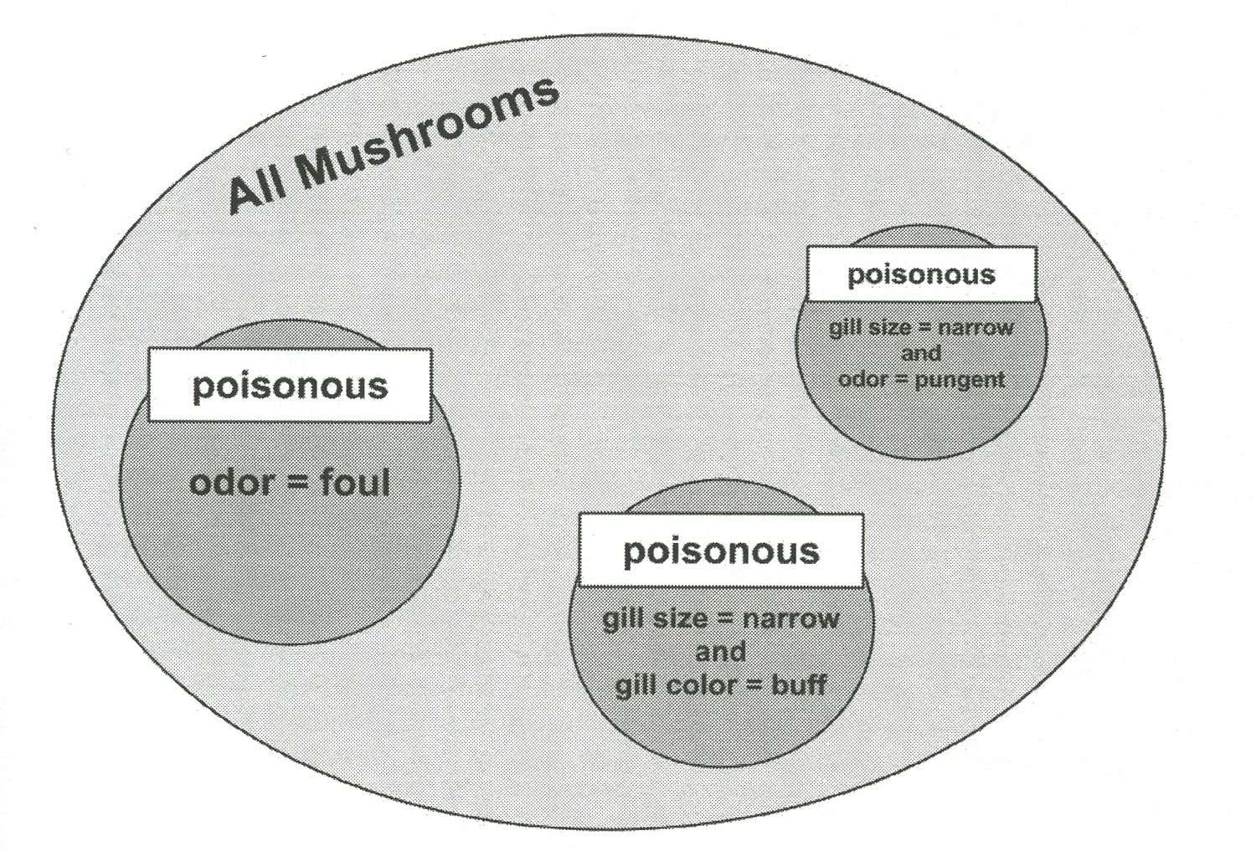
Easy to summarize for humans:
Notes:
Lantz p 157

